Slide 1
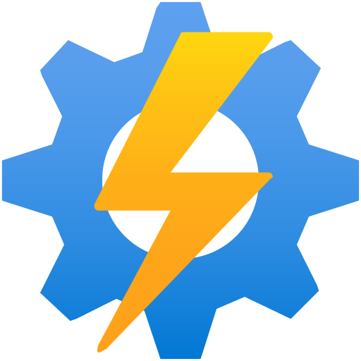
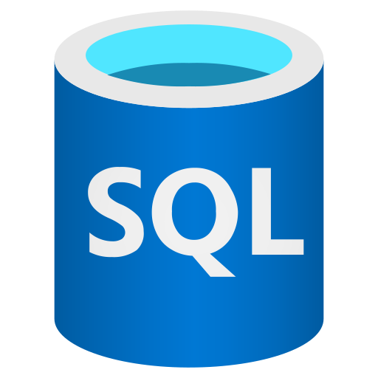
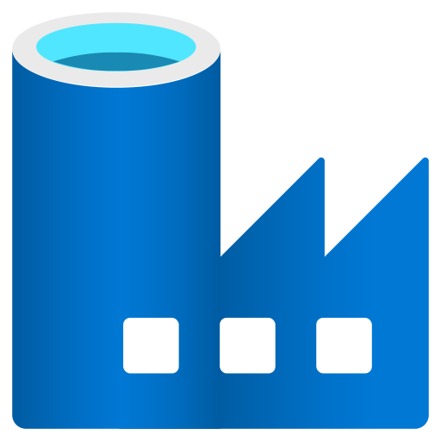

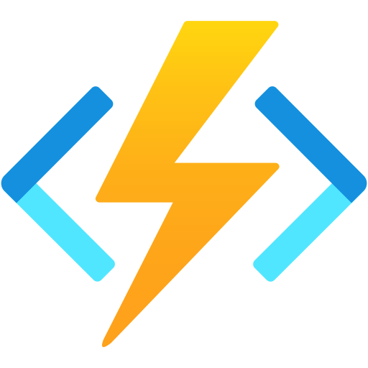
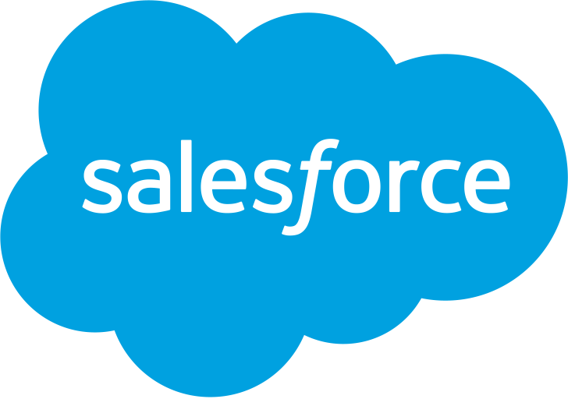

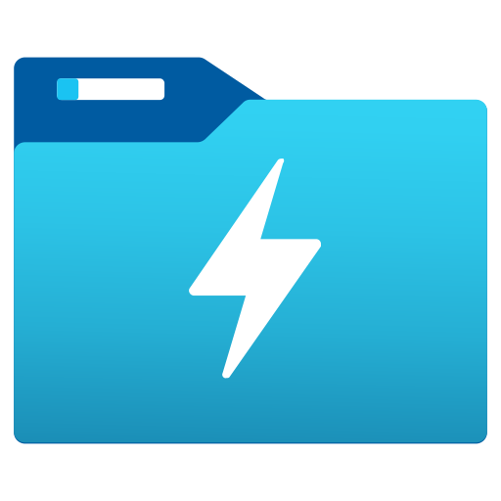
Salesforce POC & approach (DBX to Salesforce)
SDF 2.0 Modernization – moving the Salesforce outbound feed from SQL/ADF to Databricks
Current State
Source data
Output data
Salesforce
Bulk API calls
Azure Automation
AS-IS
Azure SQL
Database
Azure Data
Factory
Blob storage
Azure Function
Salesforce
Proposed future state
Transform
Generate
output file
Read file
Upload CSV
& upsert
Databricks
(Delta tables)
Databricks Notebook
(Job / Workflow)
ADLS Gen2
(output file)
DBX REST API call
(Bulk API 2.0 job)
Salesforce
(records updated)
TO-BE · POC
Other option available
Direct connection
(query & update on demand)
Establish a direct Salesforce ↔ Databricks connection;
Salesforce queries Databricks directly and tables are updated on demand – no intermediate files.
Salesforce
Databricks
ALTERNATIVE
Notes:
Current: SQL → ADF → Blob → Azure Automation triggers Azure Function → Salesforce Bulk API. Proposed: Databricks notebook writes output file to ADLS, then calls Salesforce Bulk API 2.0 via REST from Databricks – removes ADF, Automation and Function App. Alternative: direct Salesforce–Databricks connection (query on demand).

Slide 2
Option comparison & POC next steps
How the three approaches stack up for the Salesforce feed
Criteria | Current state (SQL → ADF → Function) | Proposed future state (DBX → ADLS → Bulk API) | Other option (Direct SF ↔ DBX)
Components to run | SQL DB, ADF, Blob, Automation, Function App | Databricks + ADLS only | Databricks + Salesforce connector
Orchestration | ADF + Azure Automation schedule | Single Databricks Workflow | On demand, driven from Salesforce
Data freshness | Batch | Batch (schedule set in Workflow) | Near real-time / on query
Volume handling | Bulk API | Bulk API 2.0 (large batches) | Best for query/lookup; large writes need review
Code & skills | SQL + ADF + Function code | PySpark / Python in one notebook | Connector config; Salesforce-side setup
Key risks | Many moving parts; hard to debug end to end | API limits, auth (OAuth / Key Vault), retry logic | Licensing / connector availability, security review
POC next steps
Set up Salesforce Connected App (OAuth) and store secrets in Key Vault-backed secret scope
Build notebook: Delta → output file in ADLS Gen2
Call Bulk API 2.0 from Databricks (create job, upload CSV, close, poll status)
Log success / failed records back to a Delta table
Schedule as Databricks Workflow; compare run time & cost vs current
Evaluate direct-connection option in parallel
Recommendation: proceed with the proposed future state for the POC – it replaces ADF, Azure Automation and the Function App with one Databricks Workflow while keeping the proven Bulk API pattern. Assess the direct-connection option as a follow-up.
Notes:
Adjust criteria values to match team findings from the POC.

